Slide 1
Entity Framework Debugging using SQL Server
A Detective Story

Slide 2

Story

Slide 3

Hello
Developer Advocate
At JetBrains

Slide 4
I am not a dba!

Slide 5
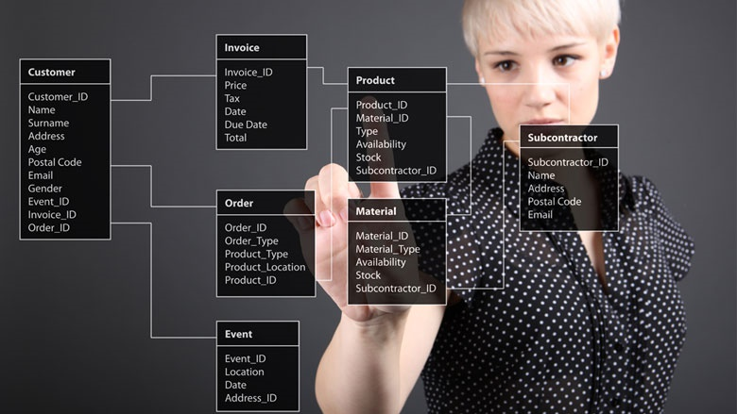
We are not going to attack DBA’s Here!

Slide 6

What we want to solve?

Slide 7


Goals for this talk!
Better use of the tools for SQL Server
Better use of Entity Framework Core for performance and happier users
Better relationship with your DBA’s!

Slide 8
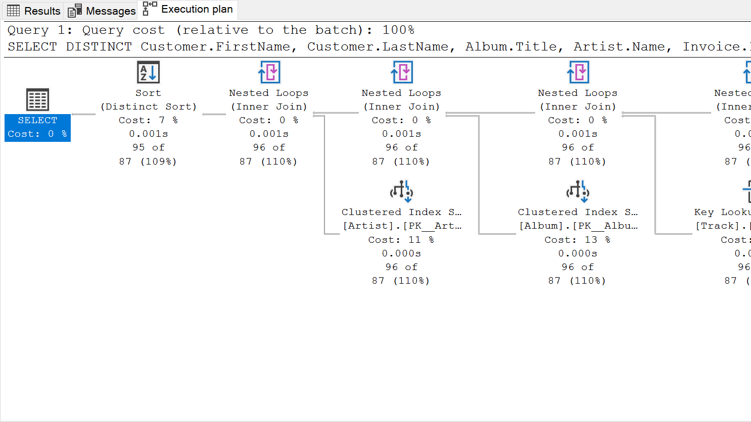
Detective Tip #1 – understand query Plans

Slide 9
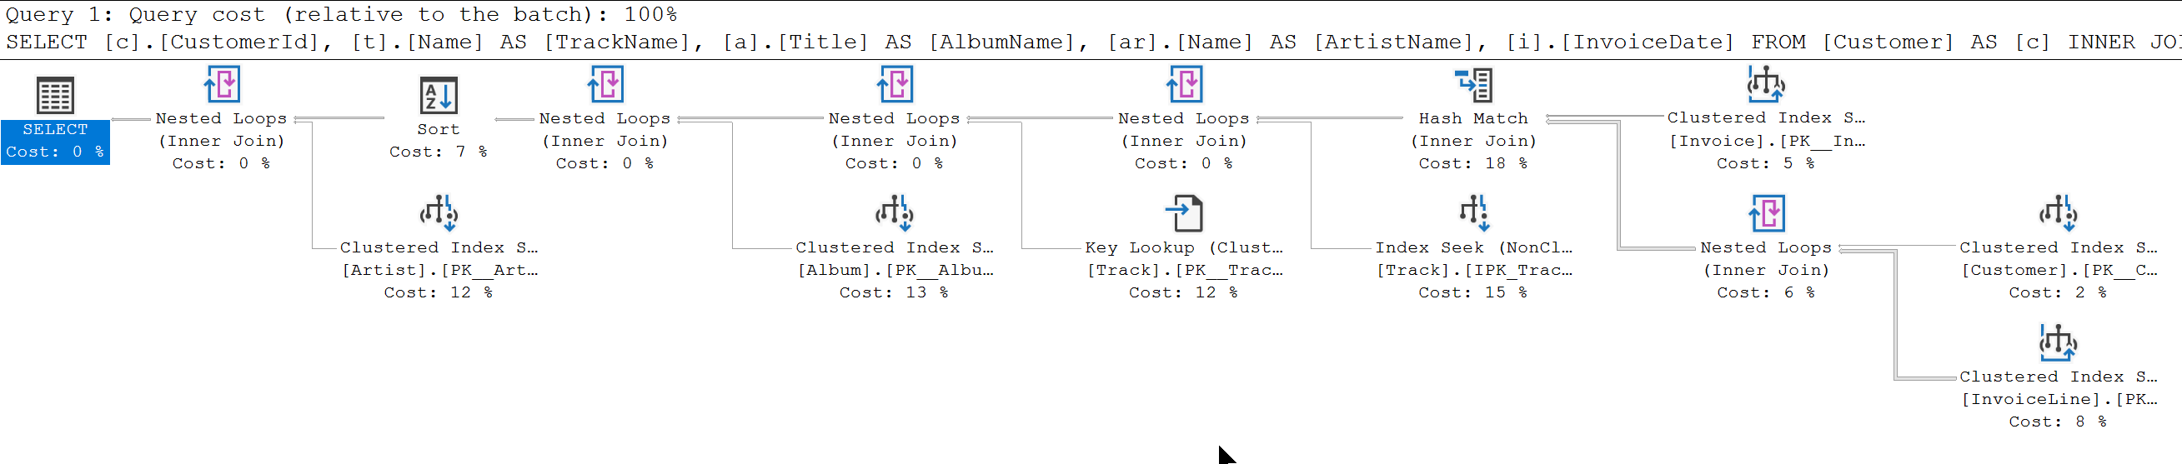
SELECT c.CustomerId, t.Name AS TrackName, a.Title AS AlbumName, ar.Name AS ArtistName, i.InvoiceDate
FROM Customer AS c
INNER JOIN Invoice AS i ON c.CustomerId = i.CustomerId
INNER JOIN InvoiceLine AS il ON i.InvoiceId = il.InvoiceId
INNER JOIN Track AS t ON il.TrackId = t.TrackId
INNER JOIN Album AS a ON t.AlbumId = a.AlbumId
INNER JOIN Artist AS ar ON a.ArtistId = ar.ArtistId
WHERE c.CustomerId = 2
ORDER BY AlbumName

Slide 10
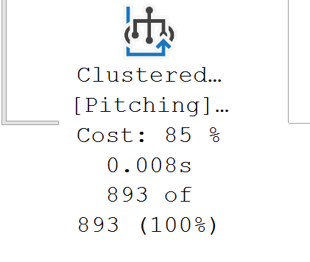
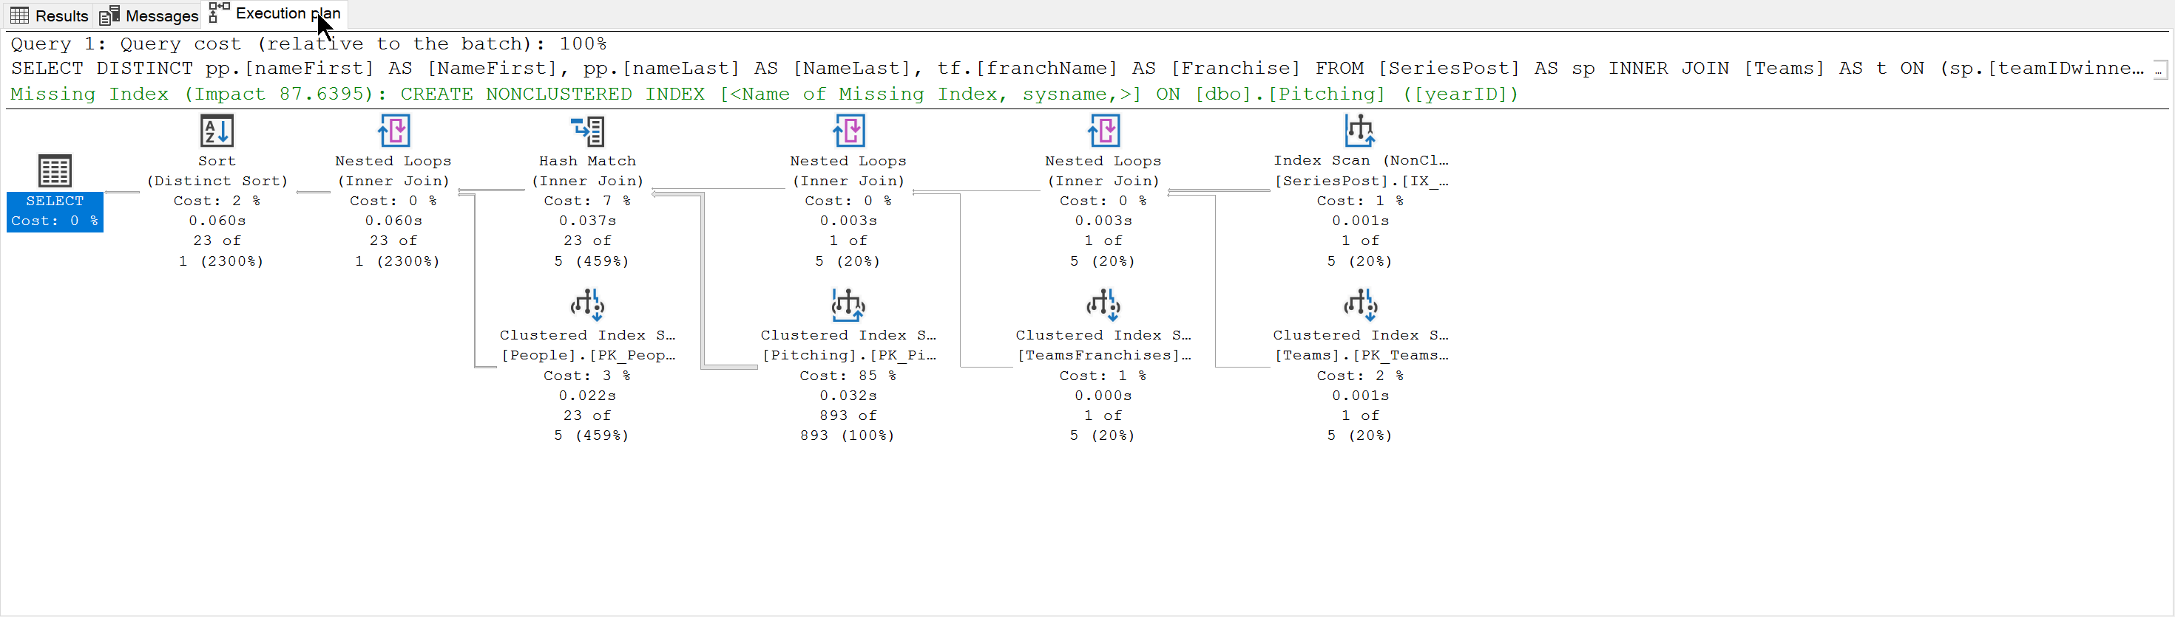
SELECT DISTINCT pp.[nameFirst] AS [NameFirst], pp.[nameLast] AS [NameLast], tf.[franchName] AS [Franchise]
FROM [SeriesPost] AS sp
INNER JOIN [Teams] AS t
ON (sp.[teamIDwinner] = t.[teamID]) AND (sp.[lgIDwinner] = t.[lgID]) AND (sp.[yearID] = t.[yearID])
INNER JOIN [TeamsFranchises] AS tf
ON t.[franchID] = tf.[franchID]
INNER JOIN [Pitching] AS p
ON (t.[teamID] = p.[teamID]) AND (t.[lgID] = p.[lgID]) AND (t.[yearID] = p.[yearID])
INNER JOIN [People] AS pp
ON p.[playerID] = pp.[playerID]
WHERE (sp.[round] = 'WS') AND (sp.[yearID] = 2018)

Slide 11

Detective Tip #2 – Query Tags and Extended Events

Slide 12
Query Tags
var albums = _context.Album.Include(a => a.Artist) .TagWith("Description: Query for Albums") .TagWith("Query located: Chinook.Controllers.AlbumsController.Index() method") .TagWith(@"Parameters: None");

Slide 13
Query Tags
-- Description: Query for Albums
-- Query located: Chinook.Controllers.AlbumsController.Index() method
-- Parameters:
-- None
SELECT [a].[AlbumId], [a].[ArtistId],
[a].[Title], [a.Artist].[ArtistId], [a.Artist].[Name]
FROM [Album] AS [a]
INNER JOIN [Artist] AS [a.Artist] ON [a].[ArtistId] = [a.Artist].[ArtistId]

Slide 14
Extended Events
CREATE EVENT SESSION [ChinookAlbumQueries] ON SERVER
ADD EVENT sqlserver.sql_statement_completed(
ACTION(sqlserver.sql_text)
WHERE (
[sqlserver].[like_i_sql_unicode_string]
([sqlserver].[sql_text], N'%SELECT%ALBUM%'))
)
WITH (TRACK_CAUSALITY=ON);

Slide 15
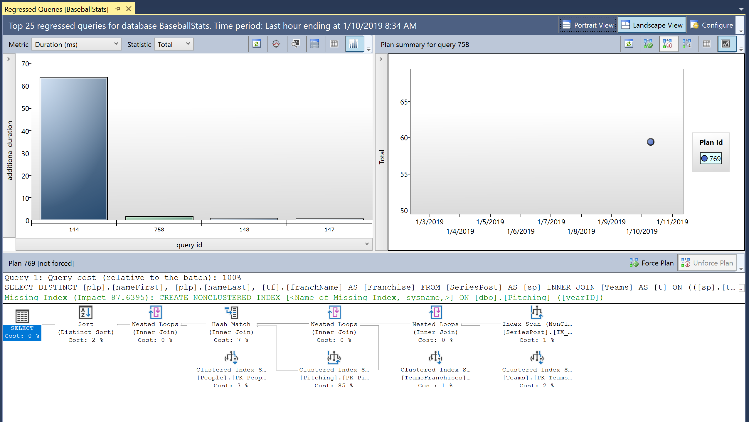
Detective Tip #3 – Learn about Query Store

Slide 16

Understanding the Query Store

Slide 17
Show how to enable Query Store
ALTER DATABASE AdventureWorks2017 SET QUERY_STORE = ON;

Slide 18

Detective Tip #4 – What we can do to improve our EF queries

Slide 19
String interpolation in raw SQL methods
var city = "Redmond";
using (var context = CreateContext())
{
context.Customers.FromSql($@“
SELECT *
FROM Customers
WHERE City = {city}");
}
var city = "Redmond";
using (var context = CreateContext())
{
FormattableString query =
$@“SELECT *
FROM Customers
WHERE City = {city}";
context.Customers.FromSql(query);
}
SELECT *
FROM Customers
WHERE City = @p0

Slide 20
Explicitly Compiled Queries
private static readonly Func<ChinookContext, AsyncEnumerable<Album>> _queryGetAllAlbums = EF.CompileAsyncQuery((ChinookContext db) => db.Album);
public async Task<List<Album>> GetAllAlbumsAsync() => await _queryGetAllAlbums(this).ToListAsync();

Slide 21
DbContext Pooling
DI Container
public class AlbumRepository : IAlbumRepository
{
private MyDBContext _context;
public AlbumRepository(MyDBContext context)
{
_context = context;
}
public async Task<List<Album>> GetAllAsync()
=> await _context.Album.ToListAsync(ct);
}
Request: /blogs/index
Scope
BlogContext
Blogs
Controller
Request: /blogs/index
Scope
BlogContext
Blogs
Controller
Request: /blogs/index
Scope
BlogContext
Blogs
Controller
Notes:
Many ASP.NET Core applications can now obtain a performance boost by configuring the service registration of their DbContext types to use a pool of pre-created instances, avoiding the cost of creating new instance for every request:

Slide 22
DbContext Pooling
DI Container
public class AlbumRepository : IAlbumRepository
{
private MyDBContext _context;
public AlbumRepository(MyDBContext context)
{
_context = context;
}
public async Task<List<Album>> GetAllAsync()
=> await _context.Album.ToListAsync(ct);
}
Request: /blogs/index
Context Pool
Scope
BlogContext
BlogContext
Scope
Blogs
Controller
BlogContext
BlogContext
BlogContext
Request: /blogs/index
BlogContext
BlogContext
Blogs
Controller
Scope
Request: /blogs/index
Scope
BlogContext
Blogs
Controller

Slide 23
DbContext Pooling
services.AddDbContext<BloggingContext>( options => options.UseSqlServer(connectionString));
services.AddDbContextPool<BloggingContext>( options => options.UseSqlServer(connectionString));

Slide 24

Be nice to your DBA!

Slide 25

Wrap Up!

Slide 26
Thanks!!!
Chris.Woodruff@JetBrains.com
https://github.com/cwoodruff/DebugEFCoreWithMSSQL

